Slide 1

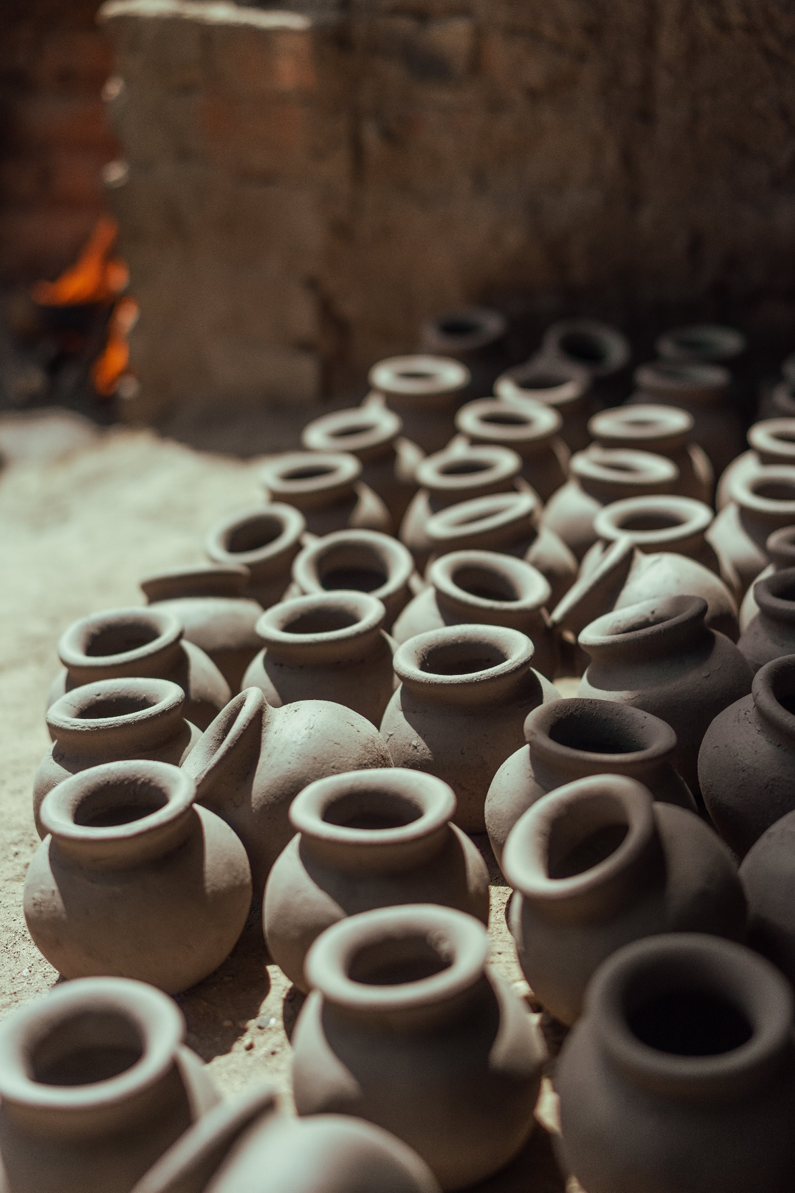

FINE CERAMIC
Professor:
Mohammad Ali Hasheminezhad
Team members:
Li Fan
Shao Jun Jiang
Le Le Wei

Slide 2
Introduction
Fine Ceramic is an online haven showcasing exquisite ceramic masterpieces for sale.
Our UI Design includes :
Home page
Log in / Sign up page
Products page
Product detail page
Shopping cart page
View ordering page
Contact us page
FAQ, About us, Order Confirmation, Terms and Conditions and 404 Pages
Database: mangoDB
Figma: https://www.figma.com/file/vAfiseRONq0pSdcLQqBF6r/e-commerce-UI-draft?type=design&node-id=157%3A156&mode=design&t=6lOK6ivUQvw0S09x-1
GitHub: https://github.com/adinashby-vanier-college/transactional-web-project-Jennifer328

Slide 3
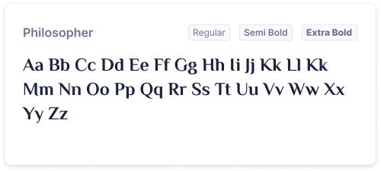
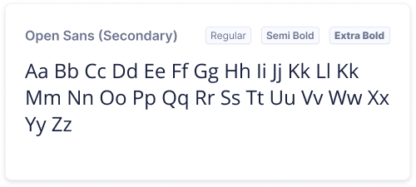

Basic Styles
Typography :
Philosopher and Open Sans
Color:

Slide 4
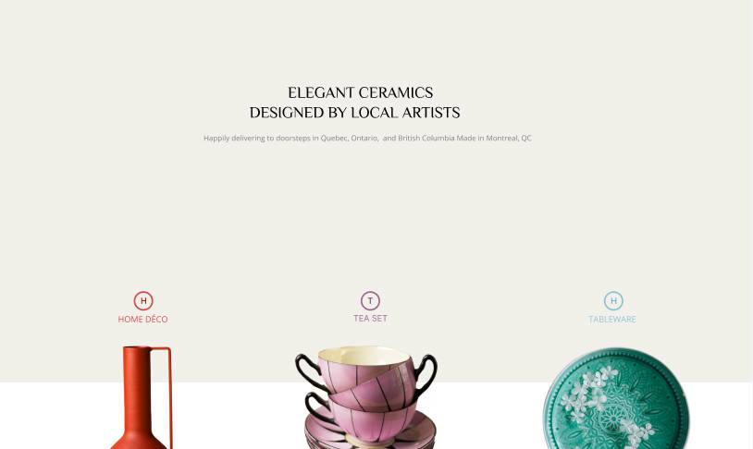
Home Page Layout
Top notification bar
Header
Hero
Direct users to our three main categories.

Slide 5
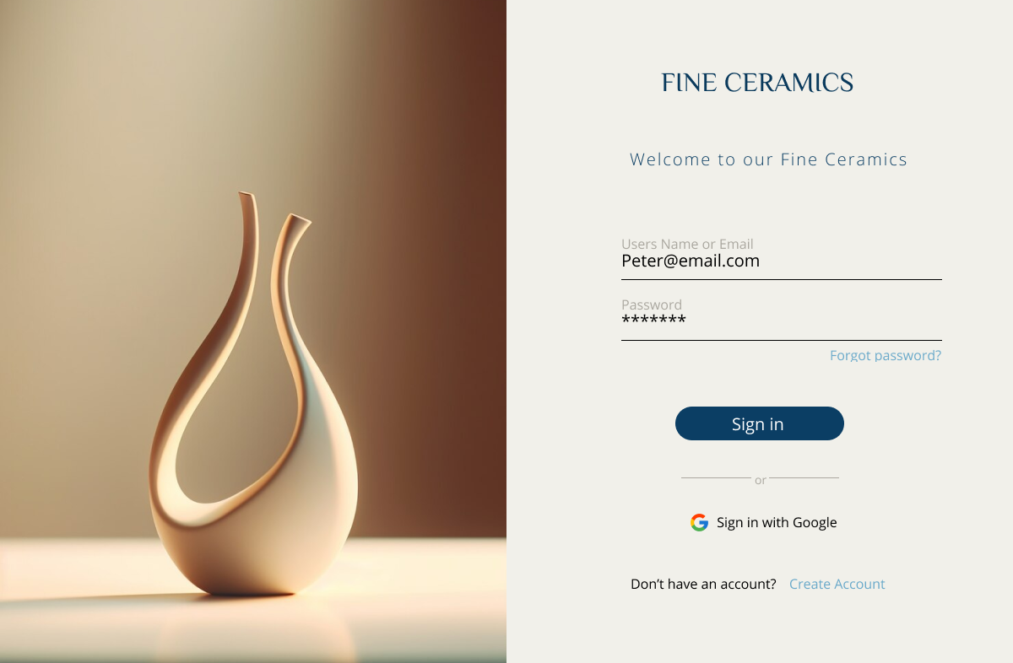
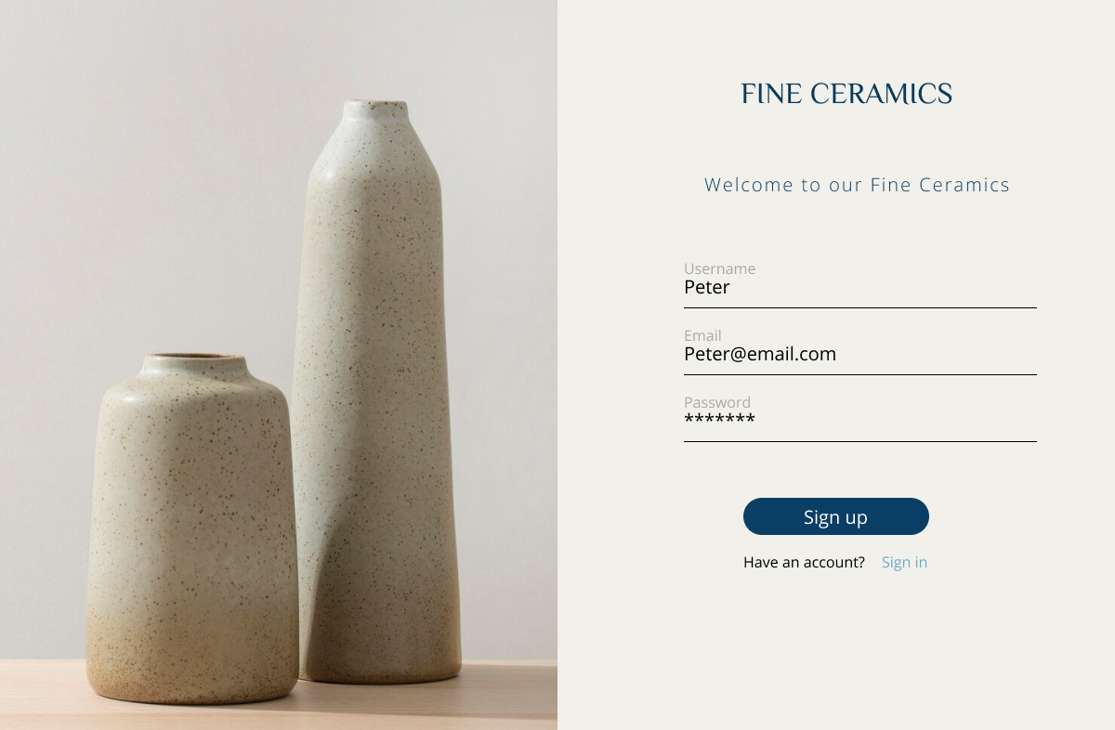
Log In / Sign Up
Our website will support both login and signup, including the option to sign up with Google.

Slide 6

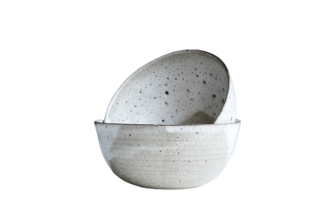
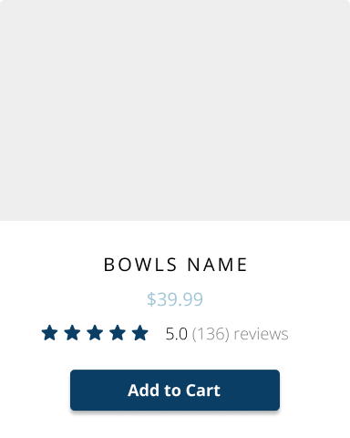

Products Page
Users navigate to the categories page from the home page
Example: tableware
Platinum
Gold
Top notification bar
Header
Hero
E-commerce cards
Footer
Find the magic and fun in presenting.
Find the magic and fun in presenting.
Find the magic and fun in presenting.
Find the magic and fun in presenting.
$42.00
$56.0
$72.00
$42.00

Slide 7
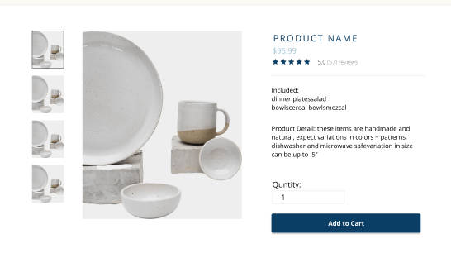

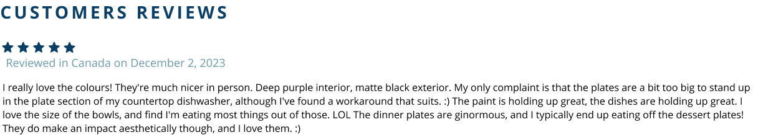
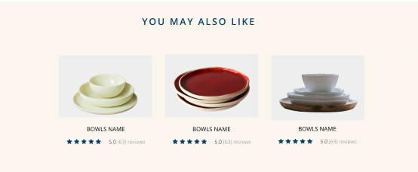
Product Details
Header
Main
Customer Reviews
Ad cards
Footer
ORDER NOW

Slide 8
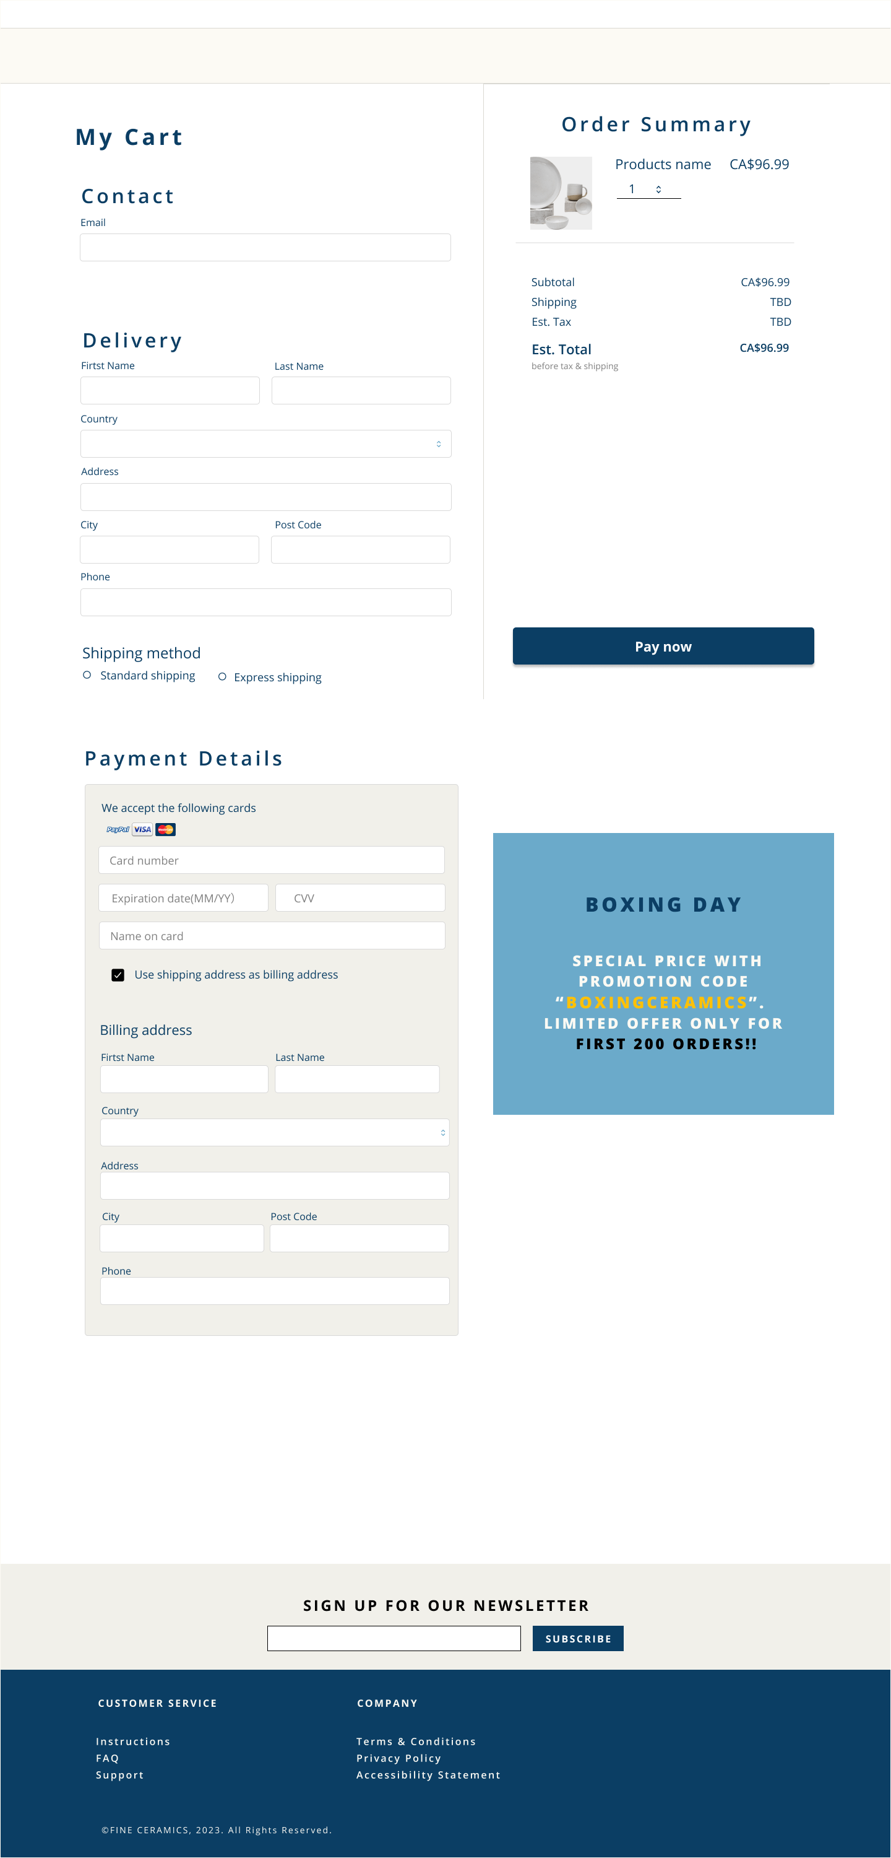
Shopping Cart
Header
Billing information& Delivery
Payment Information
Order Summary
Footer

Slide 9
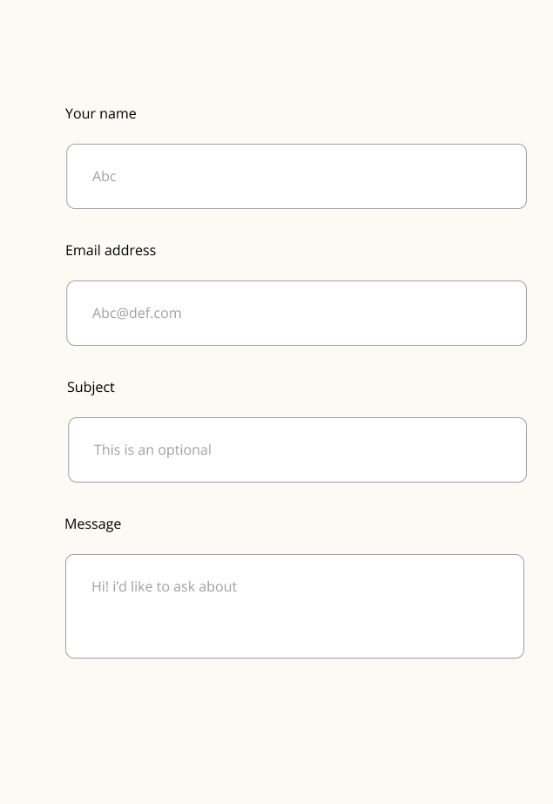
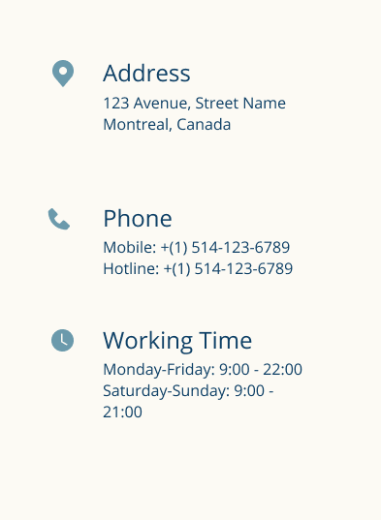
Contact us
Header
Contact
Form
Footer

Slide 10
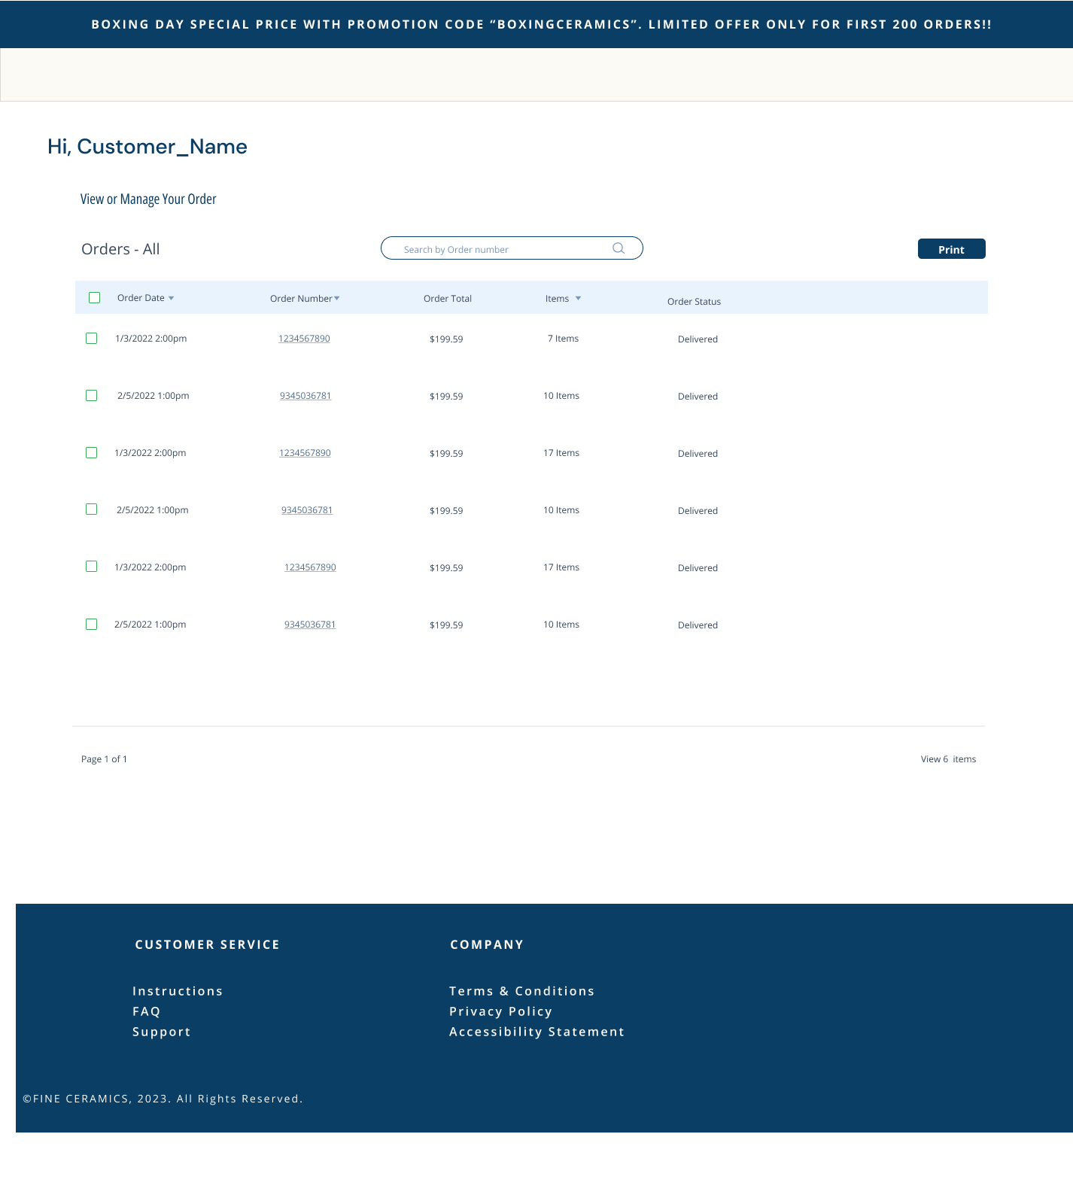
Contact us
Header
Form
Footer

Slide 11
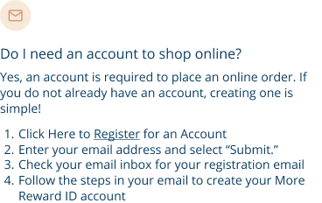
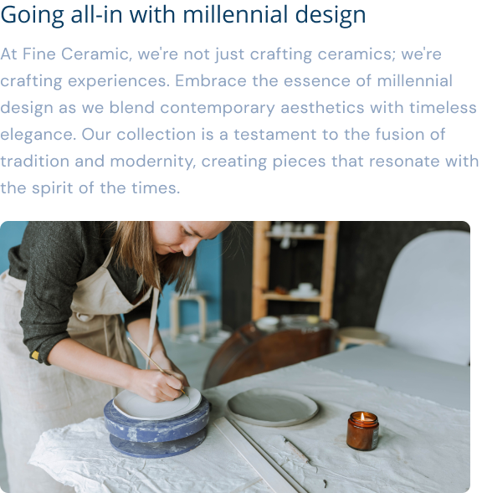
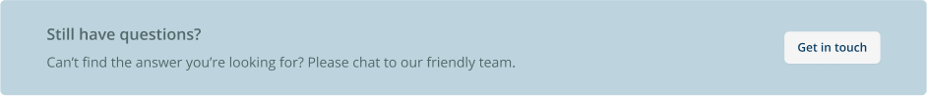
FAQ
About us
Header
FAQ
Call to action
Footer
Header
Card
Footer

Slide 12

THANK YOU FOR YOUR ATTENTION
Figma

